Slide 1
Introduction to Java for C++ Programmers
OOP in Java; Encapsulation, Inheritance, and Polymorphism

Slide 2
Inheritance and Polymorphism in Java
So far we have talked about Encapsulation, Abstraction, and intra-class design.
Main reasons for using inheritance in OO: 1- Reuse and even more important:
2- Polymorphism (an approach to program in general without using “switch” logic)
Class Object as the root of the inheritance hierarchy in Java
protected vs. private while inheriting in Java
Overriding in Java (pay attention that return types in subclasses’ overridden methods can’t be more restrictive than superclasses’ versions - in this order: 1- public, 2- protected, 3- package, 4- private)
abstract and interfaces in Java
Declaring a class or method as final
protected로 선언하면 동일 package내에서 마음대로 접근가능 → 보안상 문제 발생할 수 있음
Inheritance환경에서 superclass의 method를 subclass에서 customize하여 사용하는 것
final class → inheritance불가
final method → override 불가
Notes:
What Is Inheritance? http://docs.oracle.com/javase/tutorial/java/concepts/inheritance.html
What Is an Interface? http://docs.oracle.com/javase/tutorial/java/concepts/interface.html

Slide 3
Inheritance and Polymorphism in Java
abstract vs. final
abstract vs. interface
Check project examples in Week5_0 to Week5_4
abstract : class, method에 사용 가능, inheritance(extends)할 수 있으나,
abstract type의 object생성 불가
final : class, method, field에 사용 가능
final class type의 object 생성이 가능하나, inheritance불가
abstract class : 최소 1개의 abstract method()가 있어야 함 (do not have body)
concrete method (that has body)를 멤버로 갖을 수 있음
interface : class를 구성하는 모든 method가 abstract method여야 함
Notes:
What Is Inheritance? http://docs.oracle.com/javase/tutorial/java/concepts/inheritance.html
What Is an Interface? http://docs.oracle.com/javase/tutorial/java/concepts/interface.html

Slide 4
Inheritance Syntax in Java
If a class is a subclass of another class, you have to provide the superclass (parent) name with the following syntax:
class SomeName extends ParentName {
// field(s), constructor(s)
// method declarations
}
If a class implements one or more interfaces, you have to provide the interface names with the following syntax:
class SomeName implements InterfaceName1, InterfaceName2 {
// field(s), constructor(s)
// method declarations
}
When a class is a subclass of another class and implements one or more interfaces, then you have to use the following syntax:
class SomeName extends X implements I1, I2, I3 {
// field(s), constructor(s)
// method declarations
}

Slide 5
Checking Object Equality in Java
== checks for reference equality.
You should always use equals() method which has been inherited to all classes from class Object and override it the way you wish.
Check ObjectEquality.java

Slide 6
More on Inheritance, Polymorphism, and class Object
Method Invocation is based on the object type NOT REFERECE TYPE.
Field Access is based on reference type NOT OBJECT TYPE.
Check Base.java and Extended.java
Please study the file “Inheritance.pdf” in the files given to you.
Please study the file “Polymorphism.pdf” in the files given to you.
Check Address.java as well as Book.java, BookHashCode.java, QuizClone.java

Slide 7
More on interfaces
A collection of methods without implementation is called an interface, although in Java SE 8 an interface could have implementations through default methods and static methods.
By default, methods of interface are public and abstract.
An interface can be empty. It is called a marker/tagging interface:
public interface Marker { }
Java defines single inheritance at class level and also multiple inheritance, but only at interface level.

Slide 8
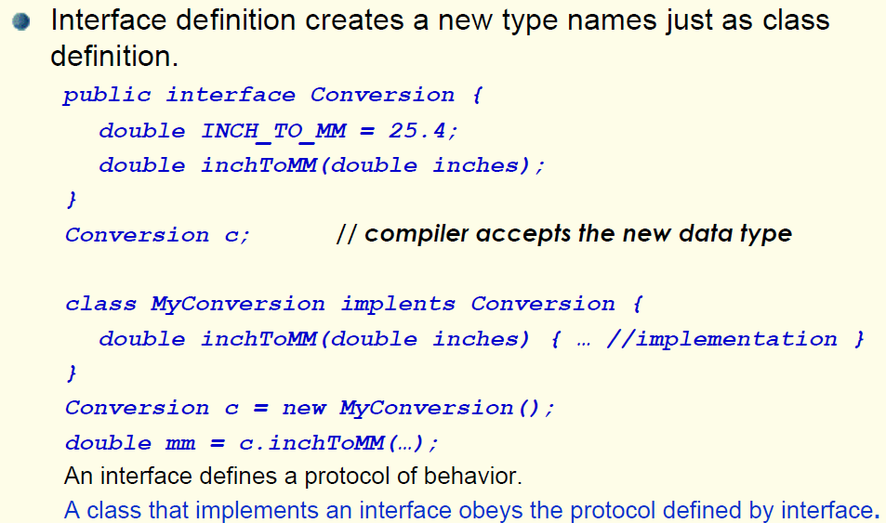
Further Study: Interface is a data type name

Slide 9
INTERFACE WITH INNER CLASS
The inner (static) class is allowed in interface declaration.
Declaring a class as a static inner class, you are communicating that the class is somehow inseparably tied to the context of the enclosing interface (Check TryInterface.java)

Slide 10
Inner Interfaces and array of interfaces
We could have inner interfaces and deal with arrays of that in Java.
Check Point.java and Plan.java.

Slide 11
OVERRIDING
The following program prints two lines. What are these lines?
class A {
public void m(int i) {
System.out.println("A: " + i);
}
public void m(String s) {
System.out.println("A: " + s);
}
}
public class PreT4 extends A {
public void m(String s) {
System.out.println("PreT4: " + s);
}
public static void main(String[] args) {
A ref = new PreT4();
ref.m(10);
ref.m("10");
}
}
Notes:
Ans. A: 10
PreT4: 10
There are two overloaded methods in class A. m(10) invokes the m(int i) method
The method m(String s) from class PreT4 is invoked, since the method is overridden in class PreT4

Slide 12
Rules for method OVERRIDING in java
A method can only be overridden in a subclass, not in the superclass.
The argument list should be exactly the same as that of the overridden method.
The return type should be the same or a subtype of the return type declared in the original overridden method in the super class.

Slide 13
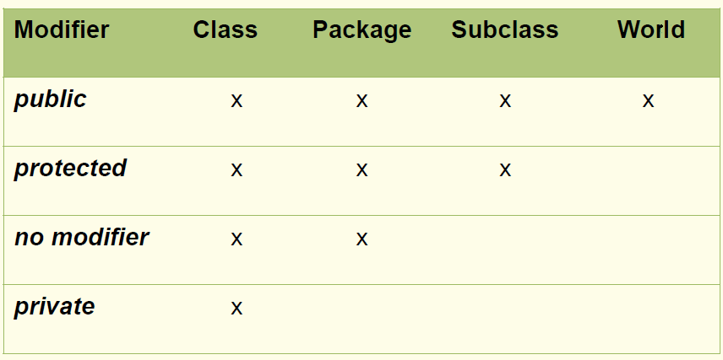
Further Study: Access Levels

Slide 14
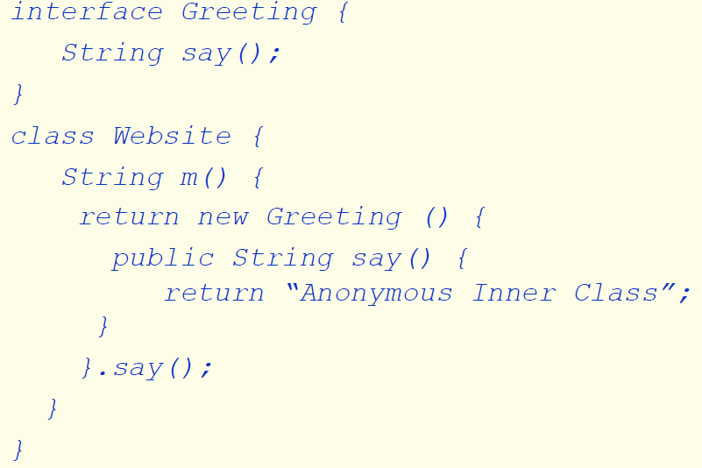
Further Study: An example of anonymous inner class

Slide 15
Further Study: Some Class Object’s Methods
toString
hashCode (study the notes and then, check HashExample.java)
equals
clone
getClass (check BookGetClass.java)
Notes:
HOW TO CALCULATE HASH CODE: The signature of hashCode is public int hashCode() How to implement hashCode() method. This is a simple algorithm implementation proposed in Josh Bloch's Effective Java Follow the steps below (consider the steps according with the data type fields you have in your class) 1. Create an int result and assign a non-zero value. For every field f tested in the equals() method, calculate a hash code partialResult: 2. If the field f is a boolean: calculate (f ? 0 : 1); 3. If the field f is a byte, char, short or int: calculate (int)f; 4. If the field f is a long: calculate (int)(f ^ (f >>> 32)); 5. If the field f is a float: calculate Float.floatToIntBits(f); 6. If the field f is a double: calculate Double.doubleToLongBits(f) and handle the return value like every long value; 7. If the field f is an object: use the result of the hashCode() method or 0 if f == null; 8.If the field f is an array: see every field as separate element and calculate the hash value in a recursive fashion and combine the values as described next. Combine the hash value partialResult with result: result = 37 * result + partialResult; Return result; This algorithm covers most of your objects

Slide 16
Some interesting fact about Stringbuffer class
StringBuffer class does not override the equals() and hashCode() methods. It inherits them directly from the Object class.
StringBuffer’s equals() method isn't overridden to check the contents. It's using the default "shallow equals" that compares the references.
It could be the case that in some special cases such as StringBuffer, the inherited method is good enough.

Slide 17
equals method
What will be printed?
class A {
public int x = 1;
}
public class B extends A {
public int x = 2;
public static void main(String[] args) {
B b = new B();
A a = b;
System.out.println(a.x == b.x);
System.out.println(a.equals(b));
System.out.println(a == b);
}
}
Notes:
Ans.
The objects have different states (different x values); the first statement: is false
The second print: true. They are equals!
The equals method for class Object implements the most discriminating possible equivalence relation on objects; that is, for any non-null reference values x and y, this method returns true if and only if x and y refer to the same object (x == y has the value true).
It is generally necessary to override the hashCode method whenever equals method is overridden.
No overridden equals and hashCode methods are defined in A and B.
The third print: true. Two references with the same value

Slide 18
hashcode method
Check ExampleHashCode.java to see the best practices for calculating hashCodes for byte, short, int, char, long, float, double, boolean, String, and array fields in your classes in Java.

Slide 19
ANONYMOUS INNER CLASS
For an anonymous inner class, what statement is true?
A- It can implement exactly one interface and extend exactly one class
B- It can implement multiple interfaces and extend exactly one class.
C- It can implement exactly one interface or extend exactly one class.
D- It can implement multiple interfaces regardless of whether it also extends a class.
Notes:
Ans. C
Option C is correct because the syntax of an anonymous inner class allows for only one named type after the new, and that type must be either a single interface (in which case the anonymous class implements that one interface) or a single class (in which case the anonymous class extends that one class).
Option A, B, and D are all incorrect because they don't follow the syntax rules described in the response for answer Option C.
http://www.indiabix.com/

Slide 20
Class Object
Class Object defines an equals(Object) method which is inherited by all its sub-classes. What is the implementation of the equals(Object) in class Object? Select the answers that match:
A- It is the same as == used to compare the references of the current object and the parameter object.
B- It is abstract (empty) and must be overridden in the extended classes.
C- It compares the values of the current object and the parameter object.
D- It is not abstract but does nothing and always returns false.
Notes:
Ans. A

